Slide 1
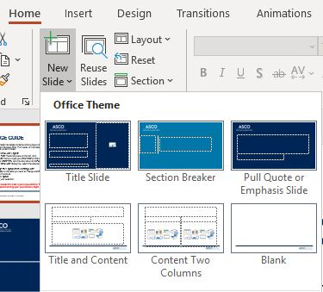
USAGE GUIDE
This presentation template contains various layout slides, including: Title Slide, Section Breaker Slide, Pull Quote or Emphasis Slide, Blank Slide, and several Content Slides.
To Add a New Slide Layout:
In the slide thumbnail pane on the left, click the slide that you want your new slide to follow.
On the Home tab, click the drop down for New Slide.
In the New Slide dialog box, select the desired layout.
To Change the Layout of an Existing Slide:
Navigate to the slide you want to change and right click on the thumbnail.
Select Layout.
Make your selection.
DO NOT include this slide in your presentation. This slide is for instructional purpose only and should be deleted upon finalizing your presentation. Right click on the thumbnail and select Delete Slide.

Slide 2
Best Presentation Practices & Resources
This slide template includes a structured outline to help you build a dynamic presentation. Please review the full deck before beginning to develop your slides.
This guidance is rooted in evidence-based education to help you prepare slides that are visually effective and structure information in a way that will support attendee understanding and retention.
For additional presentation guidance, including ASCO’s QR code policy, please review the “Presentation Resources and Directives” module in Speaker Center
Notes:
Speaker Center Link: https://asco.confex.com/asco/gucs2025/gateway.cgi

Slide 3






Education Faculty Guidance and Directives
Focus Your Talk
Cognitive overload is the enemy of learning.
Lead with the End
People remember best what they hear first and last.
Use Cases
People learn best when they apply new information to existing knowledge.
Use Images
Attendees should be listening to you speak instead of trying to read your slides.
Include Actionable Takeaways
Evidence-based, solutions-focused education provides high-quality learning.
Adhere to The Language of Respect
ASCO is committed to the use of language that demonstrates appropriate respect for patients, families, advocates, and health care providers.

Slide 5
Key Takeaway Points/Conclusions
People remember best what they hear first and last.
Directive: Include your learning outcomes/actionable takeaways at the start and end of your presentation.
Include the 1-2 main points you want people to remember from your presentation
What is directly applicable now to clinical care and/or research?

Slide 6
Provide Context for Your Key Points
People learn best when they apply new information to existing knowledge.
Connect the dots between your key points and the foundational information people already know.
Give a brief review of relevant background information – tie the points you are making into known concepts

Slide 7




Illustrate Clinical/Research Relevance
History & Physical Exam Findings
Grounding new concepts in familiar situations creates a pathway to durable learning.
Where appropriate throughout your presentation, use a scenario/clinical case to illustrate new information in real-life context (clinic or research)
Testing & Diagnostics
Clinical Course

Slide 8
Key Takeaway Points/Conclusions
Evidence-based, solutions-focused education provides high-quality learning
Reminder: People remember best what they hear first and last
Include the same 1-2 main points you listed on your first key takeaways slide
What is directly applicable now to clinical care and/or research?

Slide 9
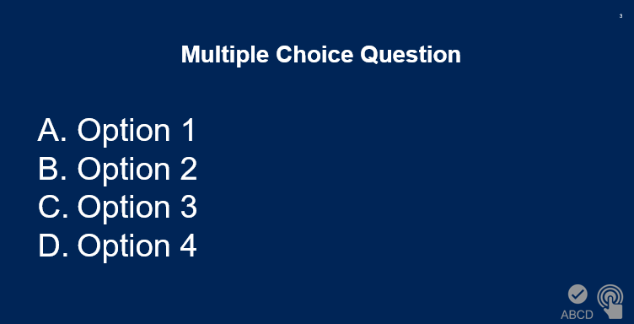
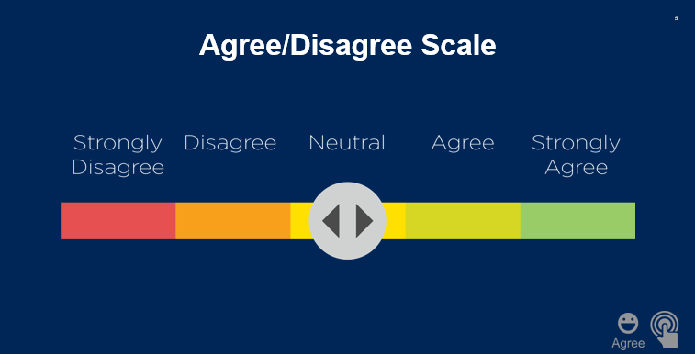

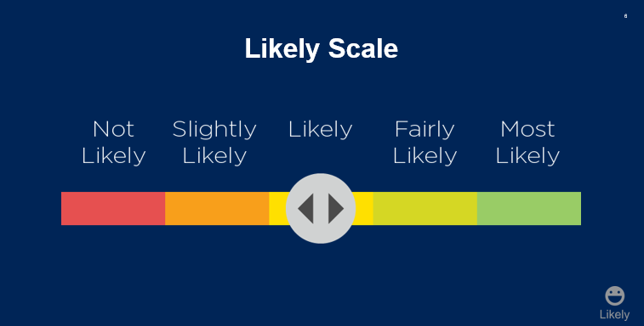
9
Available Audience Polling
Polling question templates: slides 11-14
Notes:
*When using Interactive Tools, please be sure to incorporate a ~20 second pause for attendees to send responses*

Slide 10
Important Reminders
If your slides contain images, illustrations, figures, tables, or text that has been published elsewhere or comes from another source, you are responsible for requesting and securing advance permission from the copyright holder to include the material in your slides and authorize ASCO to record the presentation. All slides which contain images, illustrations, figures, tables, or text published elsewhere must also include full reference information.
Remember to remove all patient identifying information from your slides. If your slides contain images or information about patients or other individuals, you are responsible for obtaining appropriate patient consent (including HIPAA authorization if applicable) to include the material in your slides and authorize ASCO to record the presentation.
If you or others plan to publish the data contained in your presentation, you are responsible for communicating with the publisher to determine whether the recording of your presentation for use in the Virtual Meeting and elsewhere will be considered prior publication.

Slide 11


Multiple Choice Question: Place Your Question Here
Option 1
Option 2
Option 3
Option 4
Notes:
Please note for Multiple Choice Questions:
Avoid using “All/None of the Above,” “True/False,” and “Both A and B” answers
Provide no more than 5 answer choices
Answers should be brief

Slide 12


Agree/Disagree: Place Your Agree/Disagree Statement Here
Remove the icon above when building your slides. The presentation platform will automatically input the icon beneath your slide.
Notes:
“Yes/No” answers or “Agree/Disagree” answers

Slide 13


Agree/Disagree Scale: Place Your Agree/Disagree Statement Here
Remove the icon above when building your slides. The presentation platform will automatically input the icon beneath your slide.
Notes:
“How much do you agree or disagree…?”

Slide 14


Likely Scale: Place Your Likelihood Statement Here
Remove the icon above when building your slides. The presentation platform will automatically input the icon beneath your slide.
Notes:
“How likely are you to…?”

